Slide 1
Startup Class in ASP.NET Core Application:
The ASP.NET Core application must include a Startup class. It is like the Global.asax file our traditional .NET application. As the name suggests, it is executed first when the application starts.
public class Program
{
public static void Main(string[] args)
{
var builder = WebApplication.CreateBuilder(args);
// Add services to the container.
builder.Services.AddControllersWithViews();
builder.Services.AddSingleton<IEmployeeRepository, MockEmployeeRepository>();
var app = builder.Build();
// Configure the HTTP request pipeline.
if (!app.Environment.IsDevelopment())
{
app.UseExceptionHandler("/Home/Error");
// The default HSTS value is 30 days. You may want to change this for production scenarios, see https://aka.ms/aspnetcore-hsts.
app.UseHsts();
}
app.UseHttpsRedirection();
app.UseStaticFiles();
app.UseRouting();
app.UseAuthorization();
app.MapControllerRoute(
name: "default",
pattern: "{controller=Home}/{action=Index}/{id?}");
app.run();
}

Slide 2
if (env.IsDevelopment()){
app.UseDeveloperExceptionPage();
}
app.UseRouting();
app.UseEndpoints(endpoints =>{
endpoints.MapGet("/", async context =>{
await context.Response.WriteAsync("Hello World!");
});
});
} } }

Slide 3
Configure Servicesin ASP.NET Core Startup class
The Dependency Injection pattern is used heavily in ASP.NET Core architecture. It includes the built-in IoC container to provide dependent objects using constructors.
Here you register your dependent classes with the built-in IoC container. After registering the dependent class, it can be used anywhere in the application. You just need to include it in the parameter of the constructor of a class where you want to use it.
The IoC container will inject it automatically.
ASP.NET Core refers to the dependent class as a Service. So, whenever you read “Service” then understand it as a class that is going to be used in some other class.
. For example, if you want to add RazorPages services or MVC services to your asp.net core application, then you need to add those services to the parameter this method accepts as shown in the below image.
builder.Services.AddControllersWithViews();
builder.Services.AddSingleton<IEmployeeRepository, MockEmployeeRepository>();

Slide 4
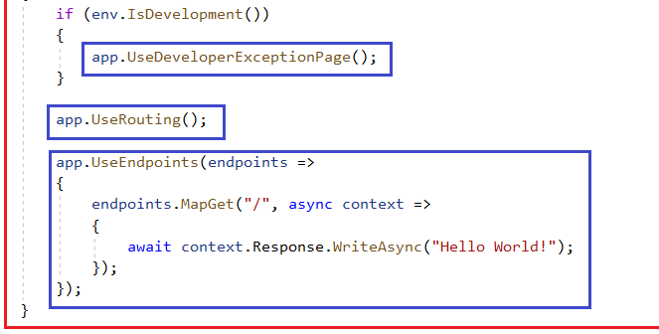
var builder = WebApplication.CreateBuilder(args);in ASP.NET Core Startup class
Here the application request pipeline for our asp.net core application using the WebApplicationBuilder instance that is provided by the built-in IoC container.
ASP.NET Core introduced the middleware components to define a request pipeline, which will be executed on every request. You include only those middleware components which are required by your application and thus increase the performance of your application.
var builder = WebApplication.CreateBuilder(args);
// Add services to the container.
builder.Services.AddControllersWithViews();
builder.Services.AddSingleton<IEmployeeRepository, MockEmployeeRepository>();
var app = builder.Build();

